Slide 1
DETECTION OF CYBERBULLYING ON SOCIAL MEDIA PLATFORMS
PROJECT GUIDE
Dr.R.BHAVANI
AP-CSE
TEAM MEMBERS
JAYANTHI T - 1817119
KIRUTHIKA S - 1817125
VARUNA PRIYA S - 1817153
YAZHINI P - 1817157

Slide 2
INTRODUCTION
Cyberbullying is a disturbing online behaviour that appears in textual format in most social media networks.
The negative effects of cyber bullying have been seen from having anxiety to having suicidal thoughts.
Cyberbullying is to be detected across multiple social media platforms using the data provided by Twitter, Wikipedia and Form spring.
We make use of Deep Learning for the purpose of detecting cyberbullying.

Slide 3
PROBLEM STATEMENT
Cyberbullying has caused significant issues for those involved, ranging from extreme displays of anger to suicide attempts.
Cyberbullying is one of the biggest problems in social media platforms like Twitter, Wikipedia etc.,
Cyberbullying is difficult to detect and stop due to it happening online.

Slide 4
OBJECTIVE
Our experiment provides several useful in-sights about cyberbullying detection. Existing works have heavily relied on traditional machine learning models for cyberbullying detection.
Our work systematically analyses cyberbullying detection on various topics across multiple SMPs using Convolution neutral network.

Slide 5
LITERATURE SURVEY
AUTHOR | TITLE | METHODOLOGY | REMARKS
Monirah Abdullah Al-Ajlan,Mourad Ykhlef | Deep Learning Algorithm for Cyberbullying Detection | 1.Tweets(dataset) 2.Word embedding 3.Classification 4.Class | Accuracy result is 81.37%
Maheep Mahat | Detection of Cyberbullying Across multiple social media platforms using deep learning. | 1.Word embedding 2.LSTM 3.Dropout 4.LSTM 5.output | Accuracy results on different datasets Wikipedia: 75.5% Twitter: 79.1% Form spring: 72%

Slide 6
AUTHOR | TITLE | METHODOLOGY | REMARKS
Vijay Banerjee, Jui Telavane. | Detection Of Cyberbullying Using Deep Neural Network. | 1.Dataset collection 2.Dataset preprocessing 3.CNN model 4.Output | Testing Accuracy for CNN model : 93.97%
Swetha Agrawal, Amit Awekar. | Deep learning for detecting cyber bullying across multiple social media platforms. | 1.Dataset collection 2.Dataset pre-processing 3.Train the DNN models 4.Output | For Form spring dataset, the accuracy is 78.5%.

Slide 7
METHODOLOGY
The proposed system consists of four main modules
Dataset collection
Dataset pre-processing
Train the DNN model : CNN(Convolutional Neural Network)
Classify the dataset as bully, sexism , racism or personal attack.

Slide 8
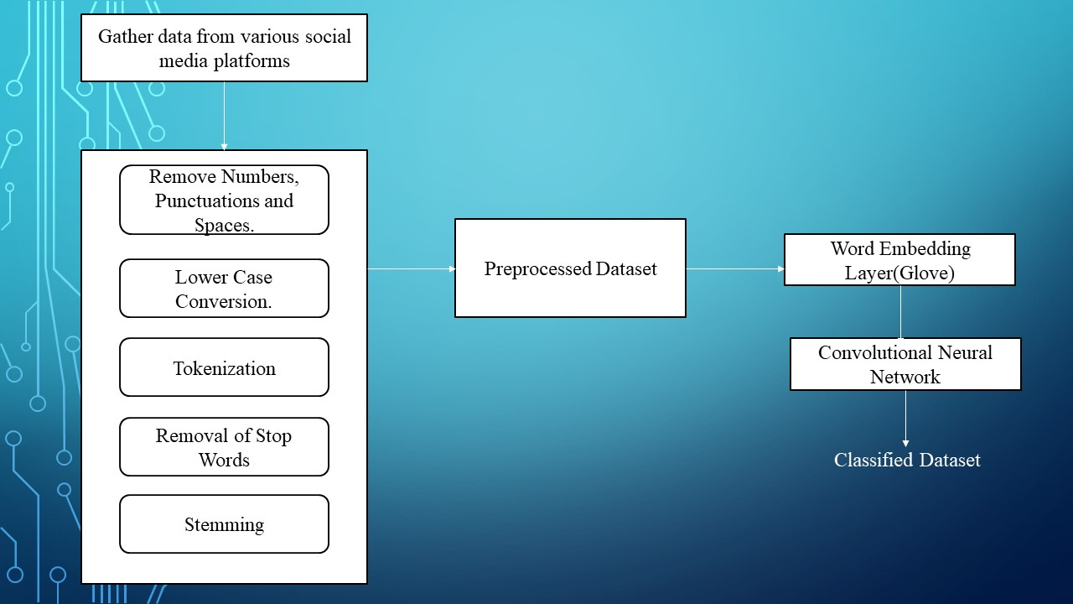

Slide 9
DATASET COLLECTION
Datasets for different types of social media networks is collected from various github repositories.
Form spring (https://github.com/JimmyCollins/cyberbullying-datasets/blob/master/datasets/formspring-data.csv)
Twitter(https://github.com/ENCASEH2020/hatespeech-twitter)
Wikipedia talk pages(https://data.mendeley.com/datasets/jf4pzyvnpj/1)
12000 posts from Form spring, 16000 posts from Twitter and 100000 posts from Wikipedia are collected from Social Media Platforms.

Slide 10
DATASET PRE-PROCESSING
Pre-processing the dataset for transforming the raw data into understandable format so that it can be sent into the model.
Removal of punctuation, capitalization, extra spaces, @name(tags), urls and numbers - Punctuation marks, blank spaces and numbers are removed from the data
Tokenizing - Process of splitting a piece of text or string into smaller units called tokens.
Removal of Stopwords - Stopwords are most commonly used words that unnecessarily take up space in the database or take up valuable processing time.
Stemming - Process of reducing a word to its word stem that affixes to suffixes and prefixes or to the roots of words known as a lemma.

Slide 11
WORD EMBEDDING LAYER
Each word is represented as a real-valued vectors known as word embedding.
This layer processes a fixed size sequence of words using padding and truncation.
There are 50,000 vocabulary words. Assign special token for words which are not in the vocabulary words.
Using Glove (Global word vector representation), the preprocessed data is converted to low dimensional vectors.
Glove works by collecting millions of words and training a neural network to learn the similarity or differences in meaning.

Slide 12
CONVOLUTIONAL NEURAL NETWORK(CNN)
DROPOUT LAYER 1:
Dropout layer is a technique used to prevent a model from overfitting.
It stays before the hidden layer at the output
The low-dimensional vectors which are the output from the embedding layer is fed into the first dropout layer of CNN to train the model.
This layer drops features randomly to avoid overfitting.
Then the output will be word vectors with minimized features.

Slide 13
CONVOLUTION LAYER :
Its task is to convolve around the input vector to detect features, therefore, it compresses the original input vector while preserving valuable features.
This is achieved by creating a set of matrices called filters of random numbers called weights.
Each input contains an arrangement of vectors. It is checked utilizing the fixed size filter. The filter moves or strides just a single row or one column over the matrix.
The output from dropout layer 1 is given to convolution layer which produces dot product output.

Slide 14
MAX-POOLING LAYER :
Pooling layer are used to reduce the spatial size of representation to reduce the amount of parameters.
The Max-Pooling layer limits the features in the Feature map.
Max pooling layer simply slides across the output of a convolutional layer and finds the maximum value of the selected area. In this way, only meaningful and clear features are preserved.
The output from convolution layer is given to max-pooling layer which produces reduced size matrix.

Slide 15
ReLu(Rectified Linear unit):
ReLu is the activation layer which boosts up the training for accurate predictions by pruning the negative values.
It sets all the negative qualities in the dot products of the matrix to 0.
The output from max pooling layer is given to dropout layer 2 which is used to increase the accuracy.
Fully Connected Layer:
The last layer of the model is Dense (Fully Connected) layer and it is utilized for classification reason. This layer groups the content dependent on the classes determined.

Slide 16
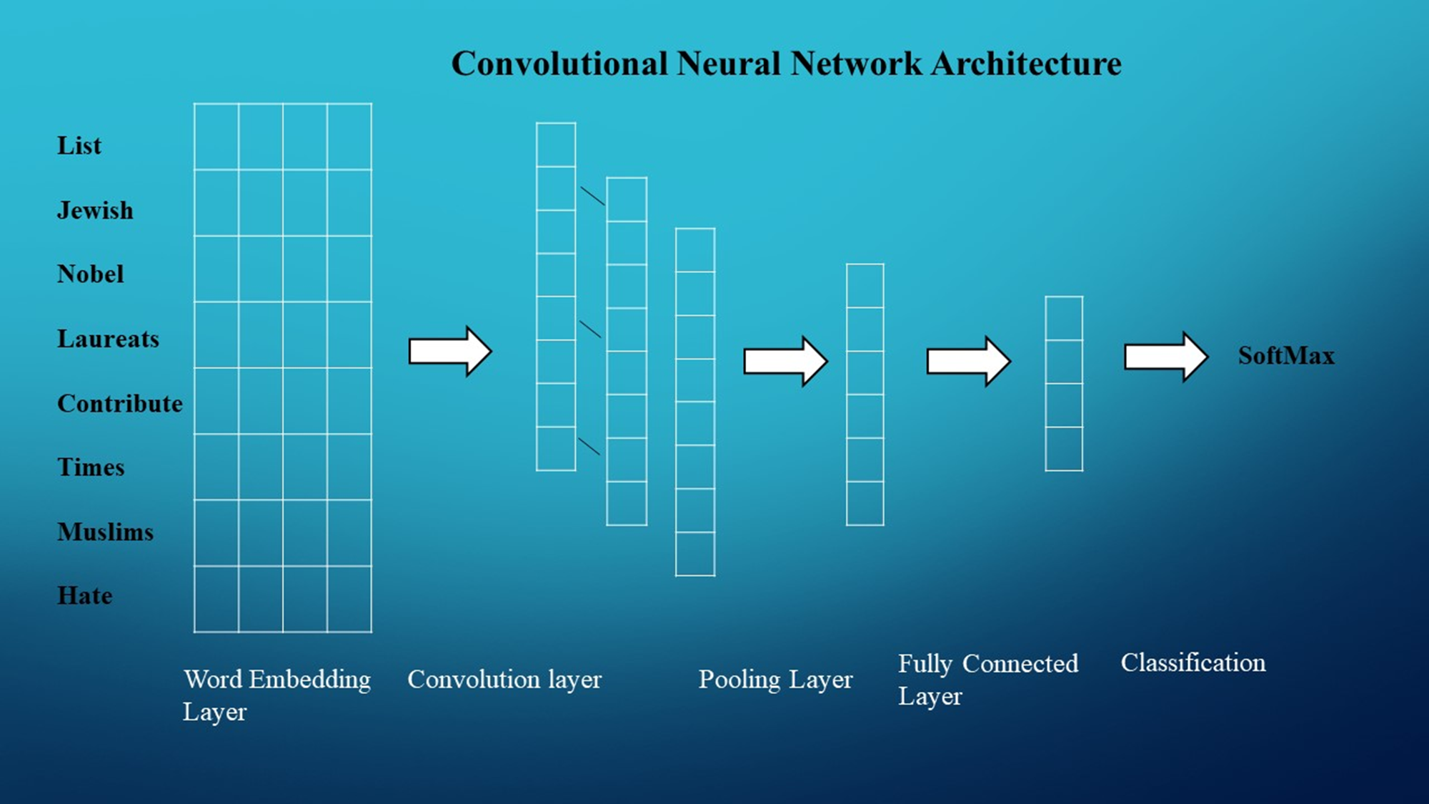
The output from dropout layer 2 is given to fully connected layer.
This layer uses soft-max function to predict the output based on probability.

Slide 17
THANK YOU

